Slide 1
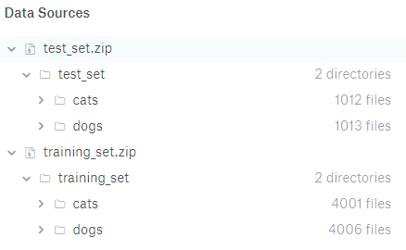
PREDICTING THE ANGLE OF ROTATION OF DOGS/CAT IMAGES
Given task is to train on images of dogs or cats after rotating the images to 0,90,180 and 270 degree respectively and predict the angle of rotation in the titled test dataset
Source is https://www.kaggle.com/tongpython/cat-and-dog
The dataset consists of 4006 images of dogs in training dataset and 1012 dog images on the test dataset
The file structure is as below

Slide 2
PROBLEMS IN THE HAND
1. Since the entire dataset consists of image of dogs (images of a single class of animals which has similar features). It is not easy for machine to distinguish these into various class as the features obtained in each of the images are almost the same. This is one of the important reasons why data augmentation works is successful and improves our model’s performance.
CNN’s have a property called rotational invariance according to which CNN’s can recognize that an image which is rotated is same as its original image. But in MLP, we do not have this problem because we flatten the image into a vector at the first layer itself by which its spatial properties are lost
2. But using MLP is not recommended for this task because of their weight vectors can get big enough that the network is overfits as the weights do not get tuned enough.
3. Using CNN is good option. Hence I have chosen CNN to work this problem

Slide 3
DATA ENGINEERING PART
1. Initially, I tried building models with the 4000 training images by transforming each of the 1000 images chunk into one of 0,90,180 and 270. Thereby having 1000 images for each class. This is also performed in the test set.
2. Since all the images where of the same object i.e dogs. It is difficult to distinguish its angle of rotation without a better representation of the image itself. Hence I decided to use image processing technique called canny filter which essentially is used to a border map of the object of interest based the input thresholds (100,200). Since there is only going to be border in our input. I assume the network be better able to distinguish angle of the images due to grouping of pixels on the one side of the image i.e face part will have a lot of close pixels with complex shape.
3. Also, Instead of performing one flip on an image. I tried performing all flips on all flips i.e single image from the training data is transformed into 4 copies of each of 0,90,180,270 degrees. Thereby increasing the generalization of the model and thus helping while testing the model.

Slide 4
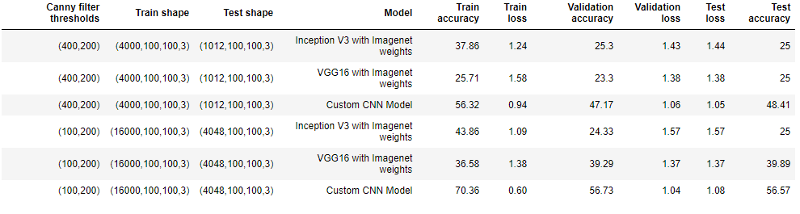
MODELS AND RESULTS
1. Models used were the standard InceptionV3 and VGG16 with imagenet weights and a custom CNN models which is explained in the iPython notebook. I also tried canny filter with two thresholds (400,200) and (100,200). All experiments are performed in the iPython notebook.

